Slide 1
Capstone Project The Battle of Neighborhoods Finding a Better Place in North York, Toronto

Slide 2
Introduction
The purpose of this Project is to help people in exploring better facilities around their neighborhood. It will help people making smart and efficient decision on selecting great neighborhood out of other neighborhoods in North York, Toronto.
This Project aim is to create an analysis of features for people migrating to North York to search a best neighborhood as a comparative analysis between neighborhoods. The features include median housing price and better school according to ratings, crime rates of that area, road connectivity, weather conditions, good management for emergency, water resources both fresh and wastewater and excrement conveyed in sewers and recreational facilities.

Slide 3
Data section
Data Source : https://en.wikipedia.org/wiki/List_of_postal_codes_of_Canada:_M
We will need data about different venues in different neighborhoods of that specific borough. In order to gain that information we will use "Foursquare" locational information.
After finding the list of neighborhoods, we then connect to the Foursquare API to gather information about venues inside each neighborhood. For each neighborhood, we have chosen the radius to be 100 meter.
The data retrieved from Foursquare, contains information of venues within a specified distance of the longitude and latitude of the postcodes. The information obtained per venue as follows:
Neighborhood
Neighborhood Latitude
Neighborhood Longitude
Venue
Name of the venue e.g. the name of a store or restaurant
Venue Latitude
Venue Longitude
Venue Category

Slide 4
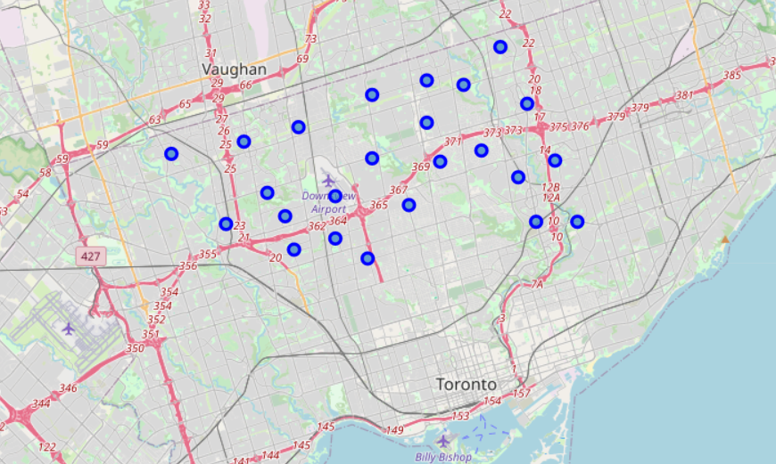
North York map

Slide 5
Methodology section
Clustering Approach:
To compare the similarities of two cities, I have decided to explore neighborhoods, segment them, and group them into clusters to find similar neighborhoods in a big city like Toronto.
To be able to do that, we need to cluster data which is a form of unsupervised machine learning: k-means clustering algorithm.
Workflow:
Using credentials of Foursquare API features of near-by places of the neighborhoods would be mined. Due to http request limitations the number of places per neighborhood parameter would reasonably be set to 100 and the radius parameter would be set to 500.

Slide 6
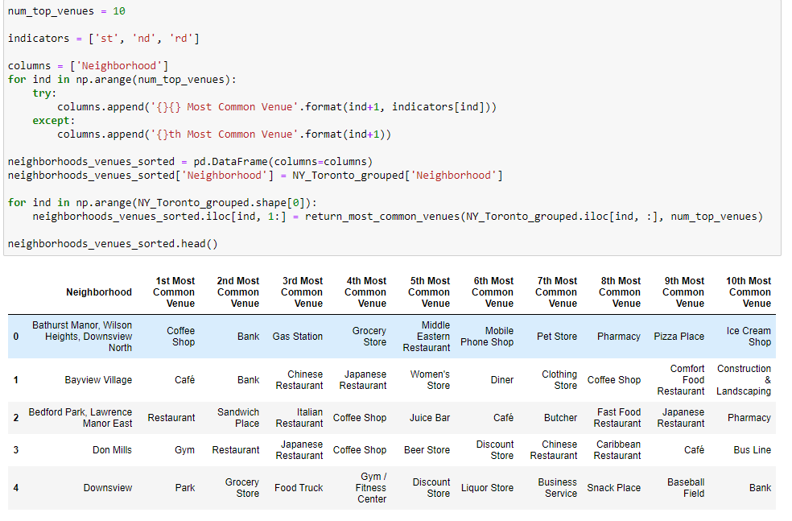
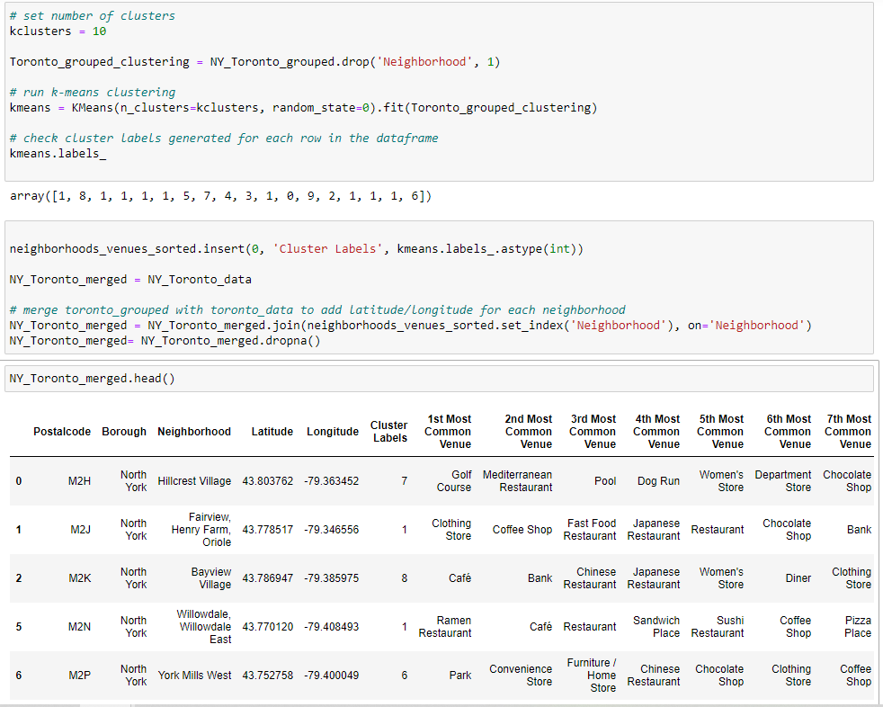
Most Common Venues near Neighborhood
Using K-Means Clustering Approach

Slide 7
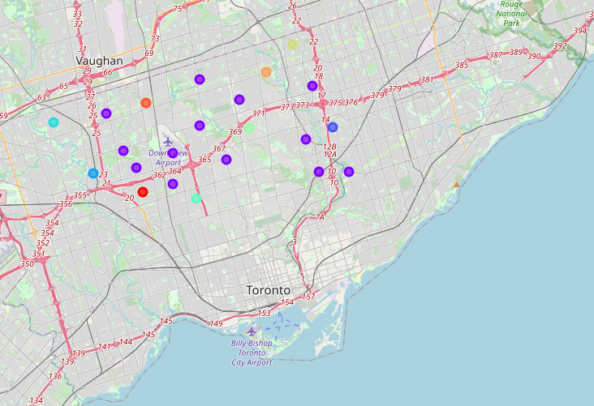
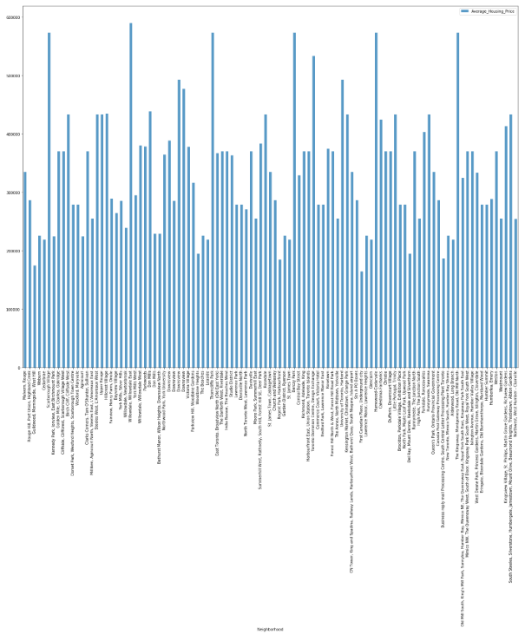
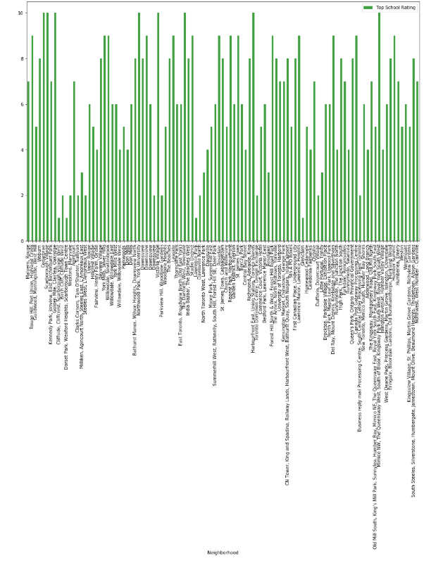
RESULT SECTION
CLUSTERS IN NORTH YORK MAP
AVERAGE HOUSE PRICING IN NORTH YORK
SCHOOL RATINGS BY CLUSTERS

Slide 8
DISCUSSION SECTION
Problem which tried to solve: The major purpose of this project is to suggest a better neighborhood in a new city for the person who are shifting to North York, Social presence in society in terms of like-minded people. Connectivity to the airport, bus stop, city center, markets and other daily needs things nearby.
Sorted list of house in terms of housing prices in an ascending or descending order and Sorted list of schools in terms of location, fees, rating and reviews.

Slide 9
Libraries Which are Used for Development
Pandas: For creating and manipulating data frames.
Folium: Python visualization library used to visualize the neighborhoods cluster distribution of using interactive leaflet map.
Scikit Learn: For importing k-means clustering.
JSON: Library to handle JSON files.
Geocoder: To retrieve Data Location.
Beautiful Soup and Requests: To scrap and handle http requests.
Matplotlib: Python Plotting Module

Slide 10
CONCLUSION
In this Capstone project, using k-means cluster algorithm I separated the neighborhood into 10 different clusters for 103 different latitude and longitude from dataset, which has very-similar neighborhoods around them.
The average house prices and school rating have been made based on the neighborhoods.
The analysis and results produced from this algorithm would help people to understand about the neighborhoods in North York.

